Slide 1
Introduction to Feature Selection
Davis David, Data Scientist

Slide 2
Learning Outcomes
After this module, we will cover the following;
What is Feature Selection
The importance of Feature Selection
Methods for Feature Selection
Implement Feature Selection Methods (Practical Session)

Slide 3
What is Feature Selection

Slide 4
What is Feature Selection
Feature Selection is the process where you automatically or manually select those features which contribute most to your prediction variable or output in which you are interested in.
Having irrelevant features in your data can decrease the accuracy of the models and make your model learn based on irrelevant features.

Slide 5
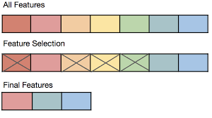
What is Feature Selection

Slide 6
The importance of Feature Selection

Slide 7
The importance of Feature Selection
1.Faster Training: Feature selection accelerates machine learning training by trimming away irrelevant attributes, allowing algorithms to focus on the most informative data, which leads to quicker convergence and reduced computation time.
2.Model Complexity and Interpretability: Selecting key features simplifies models, making them more understandable to users and stakeholders, as well as facilitating the identification of crucial factors driving predictions.

Slide 8
The importance of Feature Selection
3. Improve Model Accuracy: By retaining only the most relevant features, models can capture the essential patterns in the data, leading to improved prediction accuracy on new, unseen data.
4.Preventing Overfitting: Feature selection reduces overfitting risk by removing noise and irrelevant attributes, enabling models to generalize better to new data and avoid learning from irrelevant fluctuations in the training set.

Slide 9
The importance of Feature Selection
“I prepared a model by selecting all the features and I got an accuracy of around 65% which is not pretty good for a predictive model and after doing some feature selection and feature engineering without doing any logical changes in my model code my accuracy jumped to 81% which is quite impressive”
- By Raheel Shaikh

Slide 10
Methods for Feature Selection

Slide 11
1.Univariate Selection
Univariate feature selection is a method used for selecting features based on their individual performance in relation to the target variable, independently of the other features.
Univariate feature selection involves evaluating each feature separately to determine its statistical significance or correlation with the target variable. This is typically done using statistical tests or scoring methods like ANOVA (Analysis of Variance), chi-squared tests for categorical data,
The idea is to quantify how well each feature by itself can discriminate or explain variances in the target variable.

Slide 12
1.Univariate Selection: How it works?
1.Score Calculation: Each feature's statistical relevance or importance is computed independently, often resulting in a score. For example, in regression tasks, features might be ranked based on their F-statistic values, while in classification tasks, they might be ranked according to their chi-squared scores.
2.Feature Ranking: Features are then ranked based on their scores, from the most to the least relevant.

Slide 13
1.Univariate Selection: How it works?
3.Selection Threshold: A predetermined threshold is set, and features with scores exceeding this threshold are selected as important. Alternatively, a fixed number of top-ranked features can be chosen.

Slide 14
1.Univariate Selection: Pros and Cons
Pros:
Univariate feature selection is straightforward and computationally efficient, making it particularly useful when dealing with high-dimensional datasets where the number of features is large.
Cons:
Univariate feature selection doesn't consider potential interactions between features, which might result in important features being overlooked if their significance only becomes apparent when considered together.

Slide 15
2.Feature Importance
Feature importance is like a tool that tree-based classifiers (which are a type of machine learning algorithm) use to decide which parts of the data are most helpful in making predictions.
These algorithms observe how much each feature affects the outcomes and assign scores to them. Higher scores mean the feature is more important. By looking at these scores, you can decide which features are really necessary for making good predictions and which ones can be left out.

Slide 16
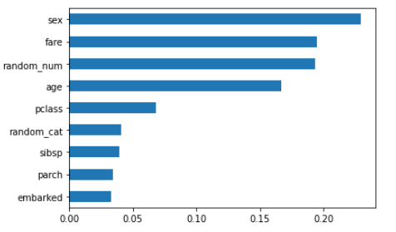
2.Feature Importance
Feature importance is an inbuilt class that comes with Tree Based Classifiers
Example:
Random Forest Classifiers
Extra Tree Classifiers

Slide 17
2. Feature Importance: Pros and Cons
Pros: Feature importance provides a clear and intuitive way to understand the impact of each feature on the model's predictions. This helps in explaining and justifying the model's behaviour to stakeholders and non-technical audiences
Cons: If your data has complex linear relationships, tree-based classifiers might not capture these variations effectively, leading to feature importance scores that might not fully reflect their true impact..

Slide 18
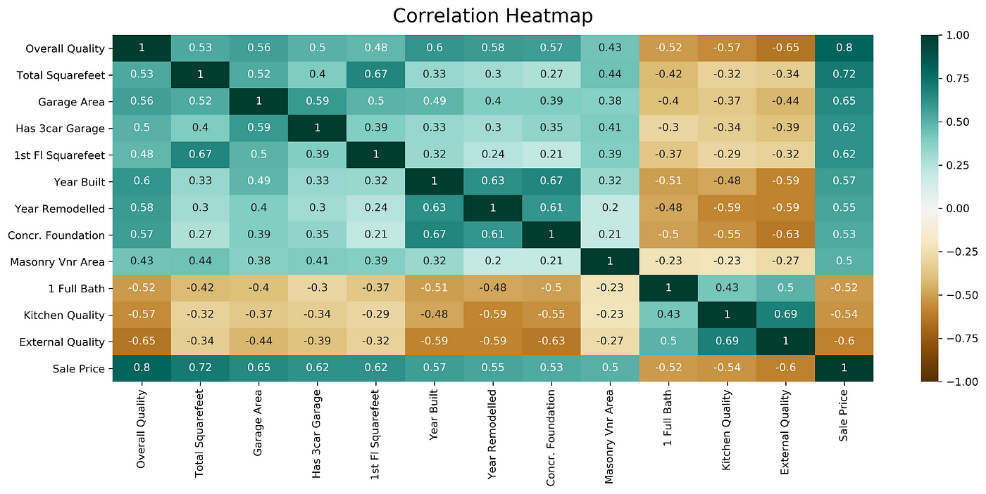
3. Correlation Matrix with Heatmap
A Correlation Matrix with Heatmap is a visual tool used in feature selection within the field of machine learning to understand and identify relationships between different features (variables) in a dataset.

Slide 19
3. Correlation Matrix with Heatmap: Types of Correlation
1.Positive Correlation:
Positive correlation indicates that as one variable increases, the other variable tends to increase as well. In other words, the two variables move in the same direction.
2.Negative Correlation:
Negative correlation means that as one variable increases, the other variable tends to decrease. These two variables move in opposite directions.

Slide 20
3. Correlation Matrix with Heatmap: Types of Correlation
3.No Correlation (Zero Correlation):
No correlation implies that changes in one variable do not have a consistent relationship with changes in the other variable. The correlation coefficient is close to 0 in this case. It's important to note that lack of correlation doesn't mean there's no relationship between the variables; it just means that their changes don't consistently correspond.

Slide 21
Thanks
davis@dlab.or.tz

